Slide 1

Project Title - Optimizing Agricultural Yield and Profitability: A Seasonal Performance Analysis
Student Name: K S Sreeniranjan
College Name-: Nehru College of Engineering and Research Centre
AICTE STU ID : STU69aed98b157c21773066635

Slide 2

PROBLEM STATEMENT
Agricultural activities are influenced by seasonal variations in environmental conditions, farming practices, resource availability and market conditions. As a result, agricultural performance may differ from one season to another. However, raw agricultural data does not clearly explain how agricultural performance changes across seasons or what patterns can be observed in different seasonal conditions. The problem is to analyze the given agricultural dataset and investigate seasonal differences in agricultural performance by identifying meaningful patterns, trends, relationships and variations within the available data.

Slide 3
Project Description: An exploratory data analytics project investigating seasonal variations in crop yield, financial profitability, environmental parameters, and resourcemanagement across4,000 farm samples

Slide 4

WHO ARE THE END USERS?
1. Farmers & Agricultural Cooperatives (Optimal seasonal crop choices)
2. Policymakers & Government Agencies (Targeted subsidies & water management)
3. Agritech & Supply Chain Managers (Resource scheduling & market pricing)

Slide 5

Technology Used
Python, Pandas, Matplotlib, Seaborn, Google Colab, Jupyter Notebook

Slide 6
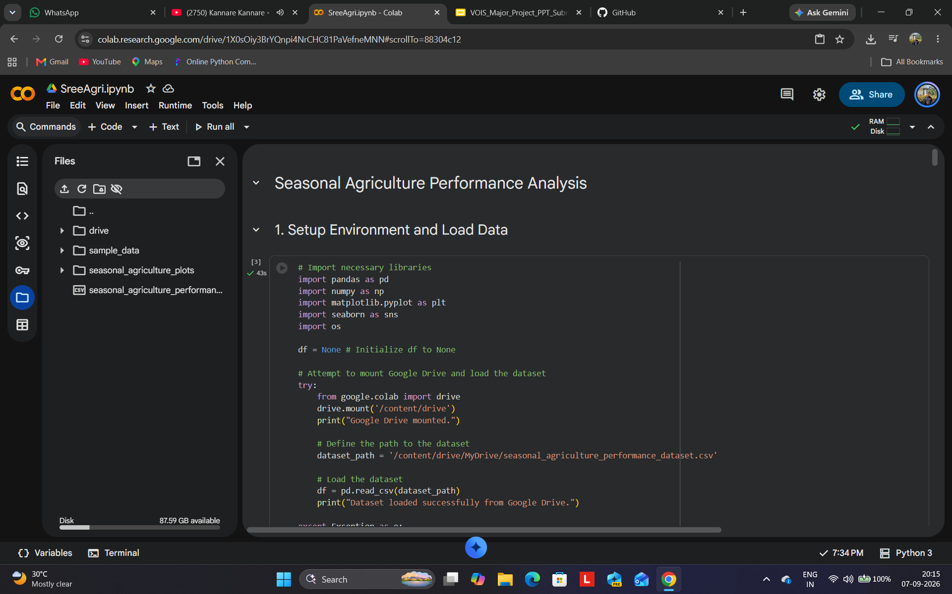
RESULTS
[Add screen shots of your code ]

Slide 7
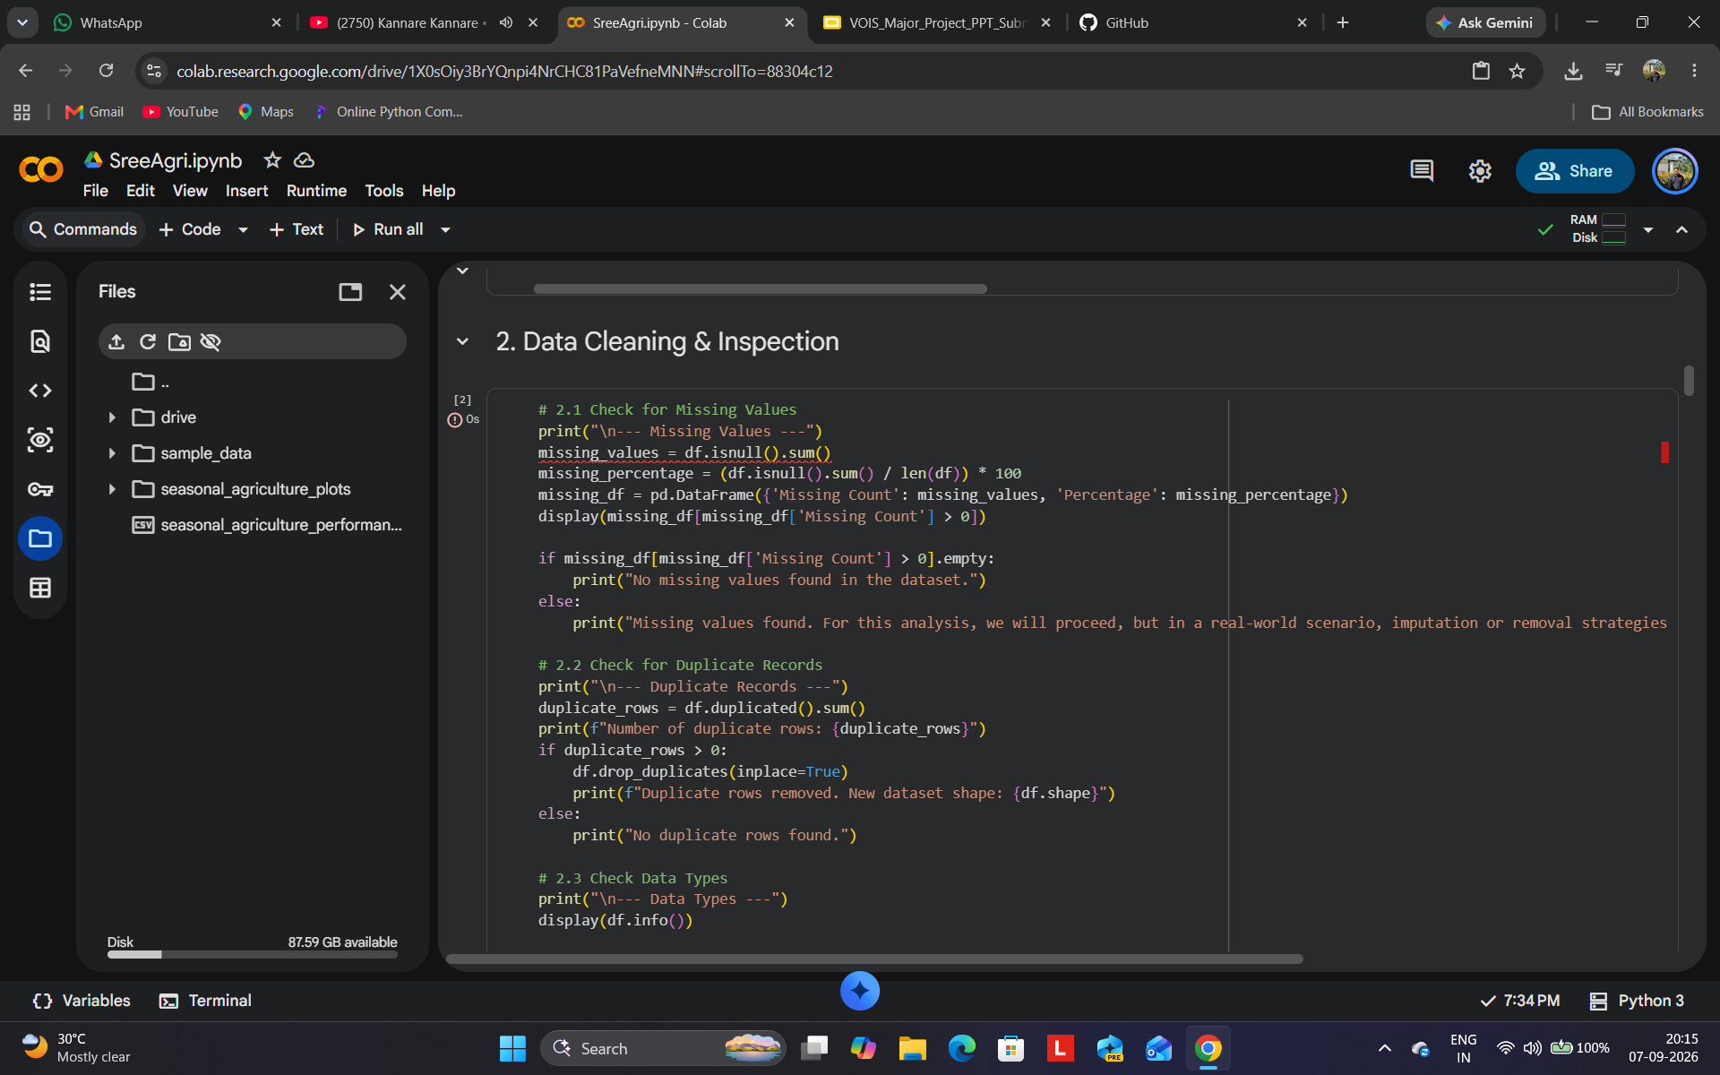
RESULTS
[Add screen shots of your code ]

Slide 8
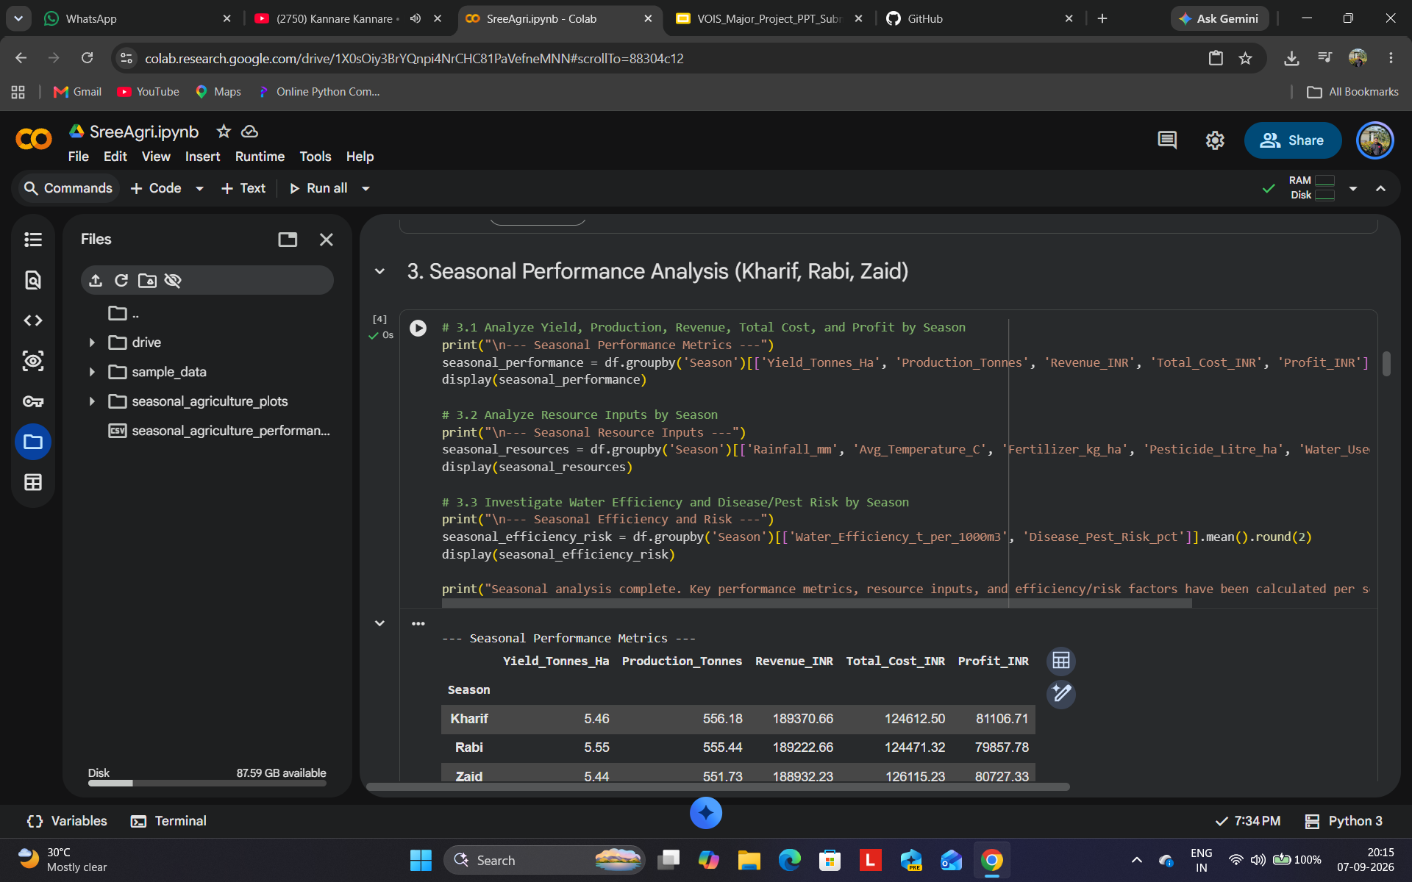
RESULTS
[Add screen shots of your code ]

Slide 9
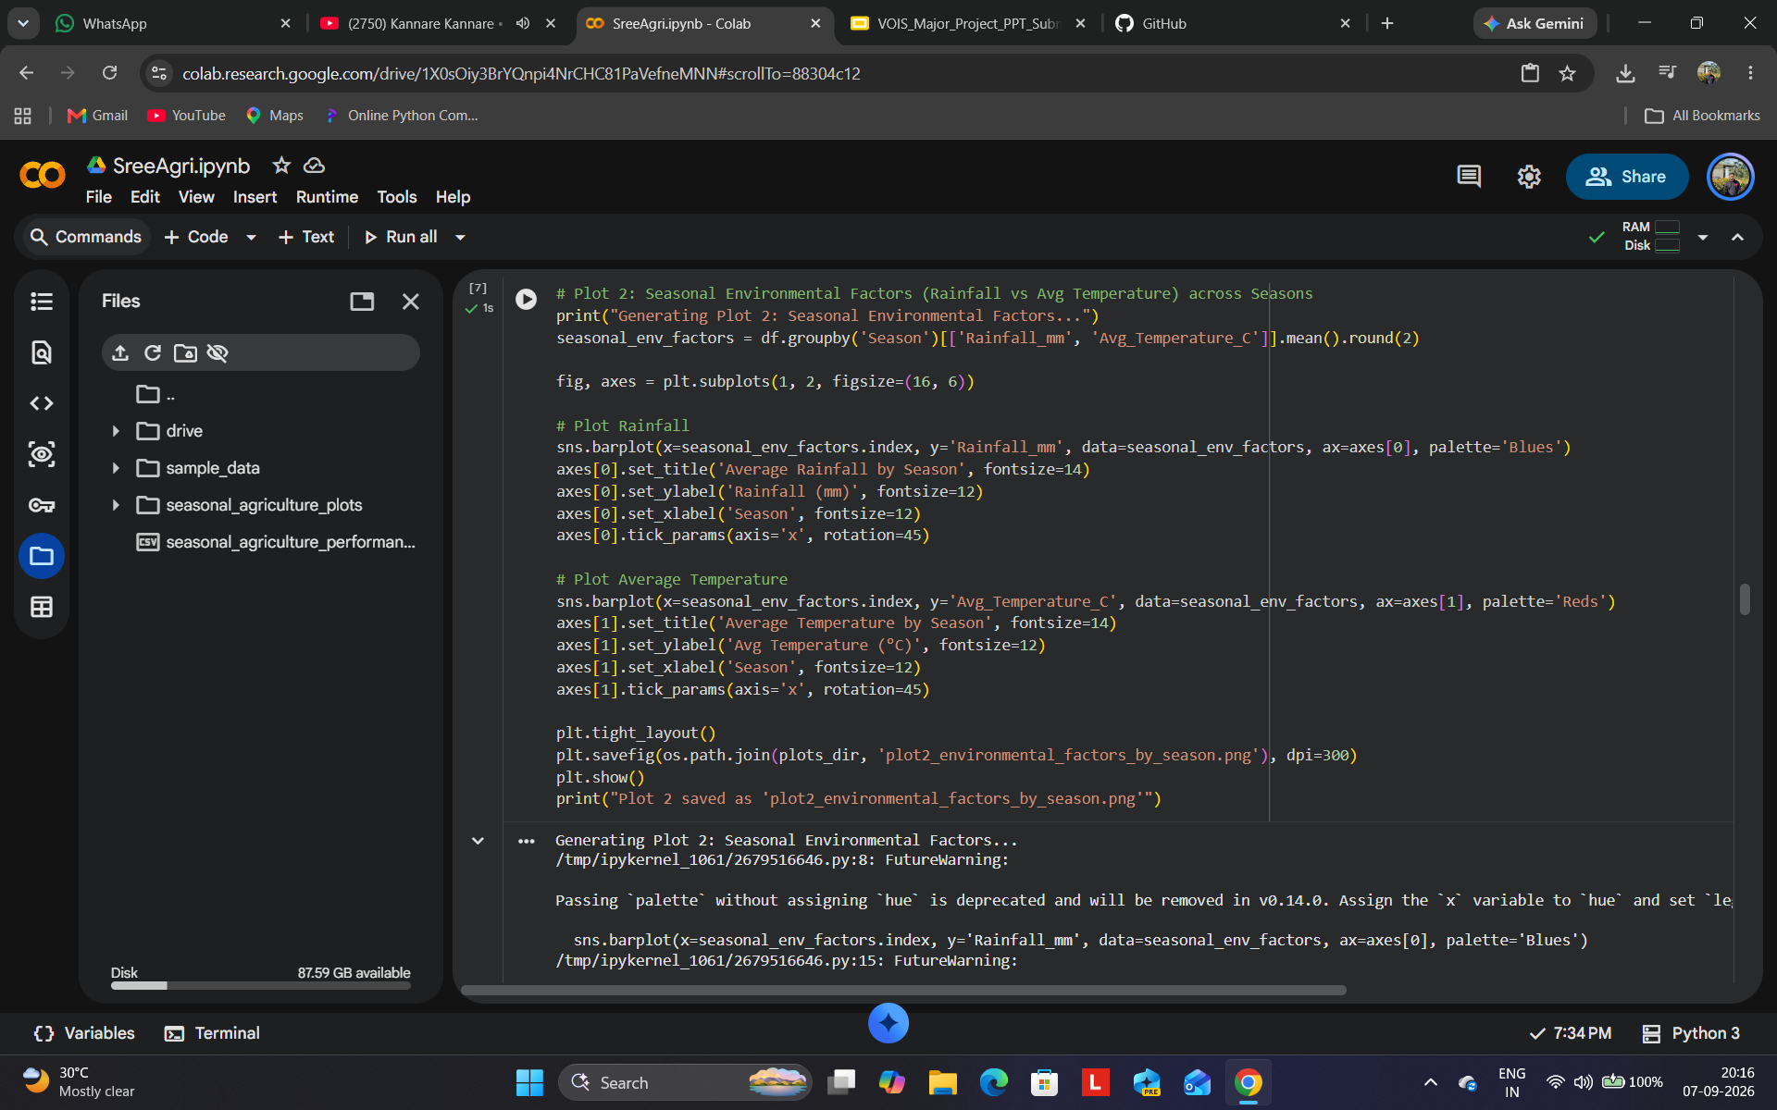
RESULTS
[Add screen shots of your code ]

Slide 10
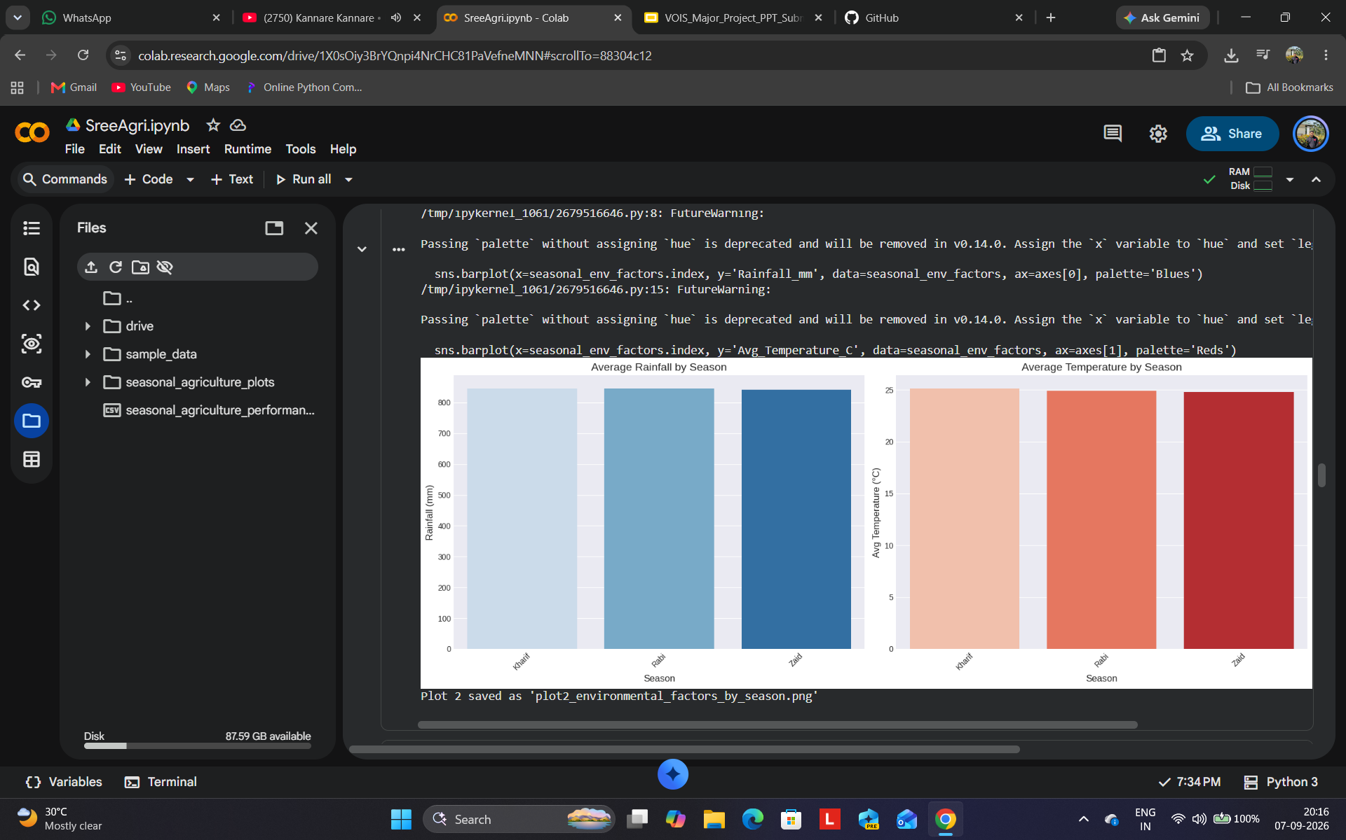
RESULTS
[Add screen shots of your code ]

Slide 11
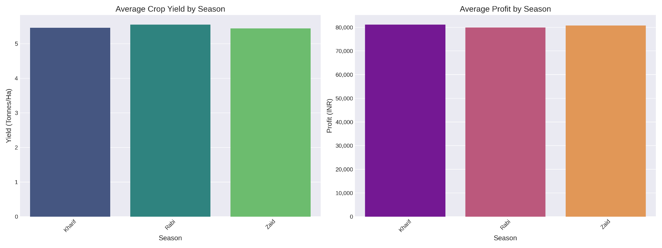
RESULTS
[Add screen shots of your code ]

Slide 12
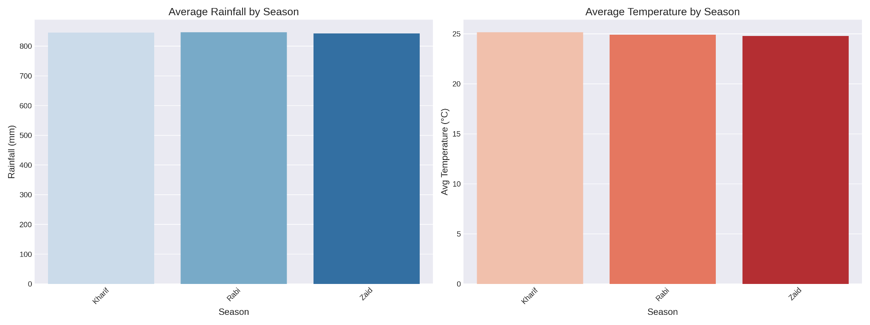
RESULTS
[Add screen shots of your code ]

Slide 13
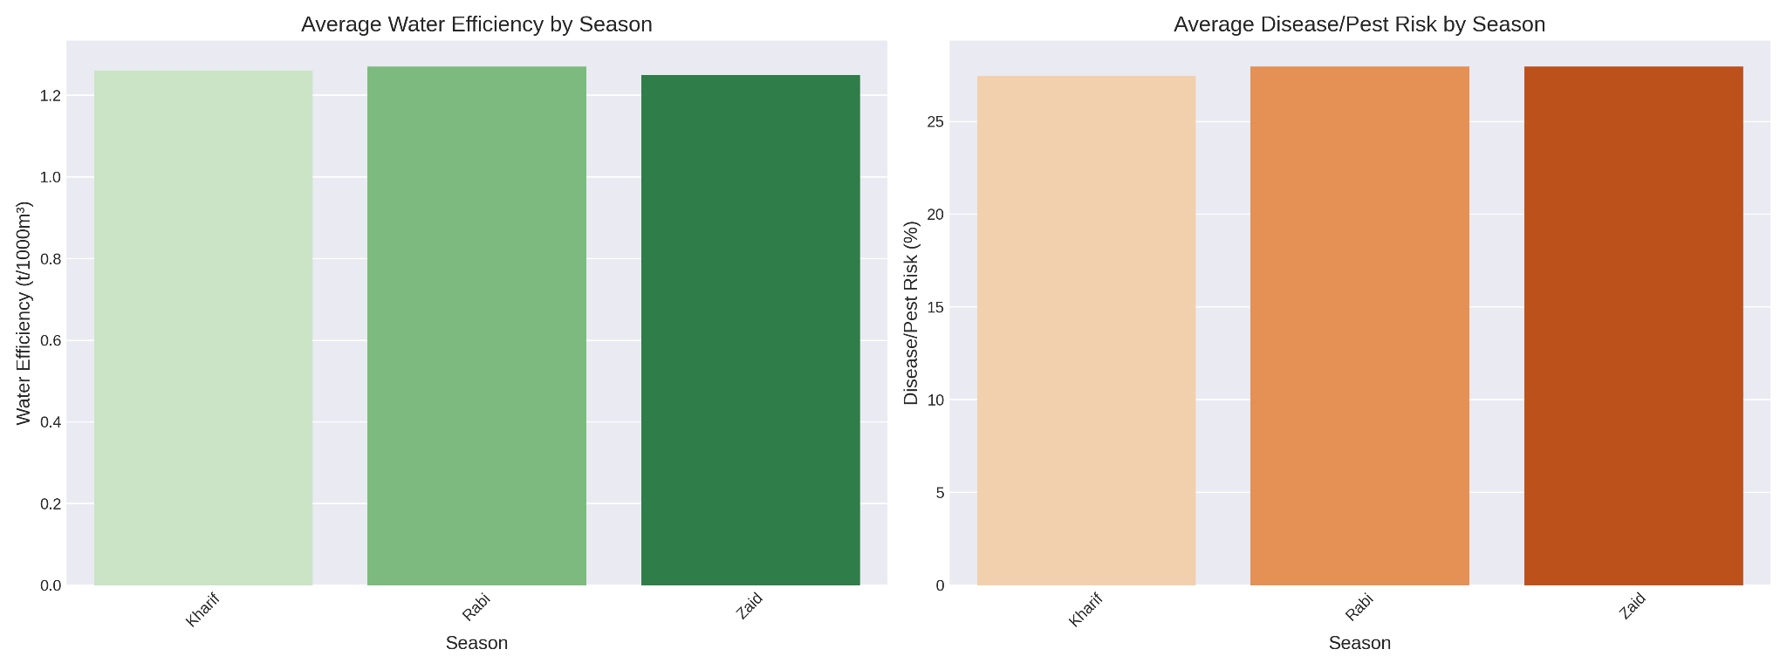
RESULTS
[Add screen shots of your code ]

Slide 14
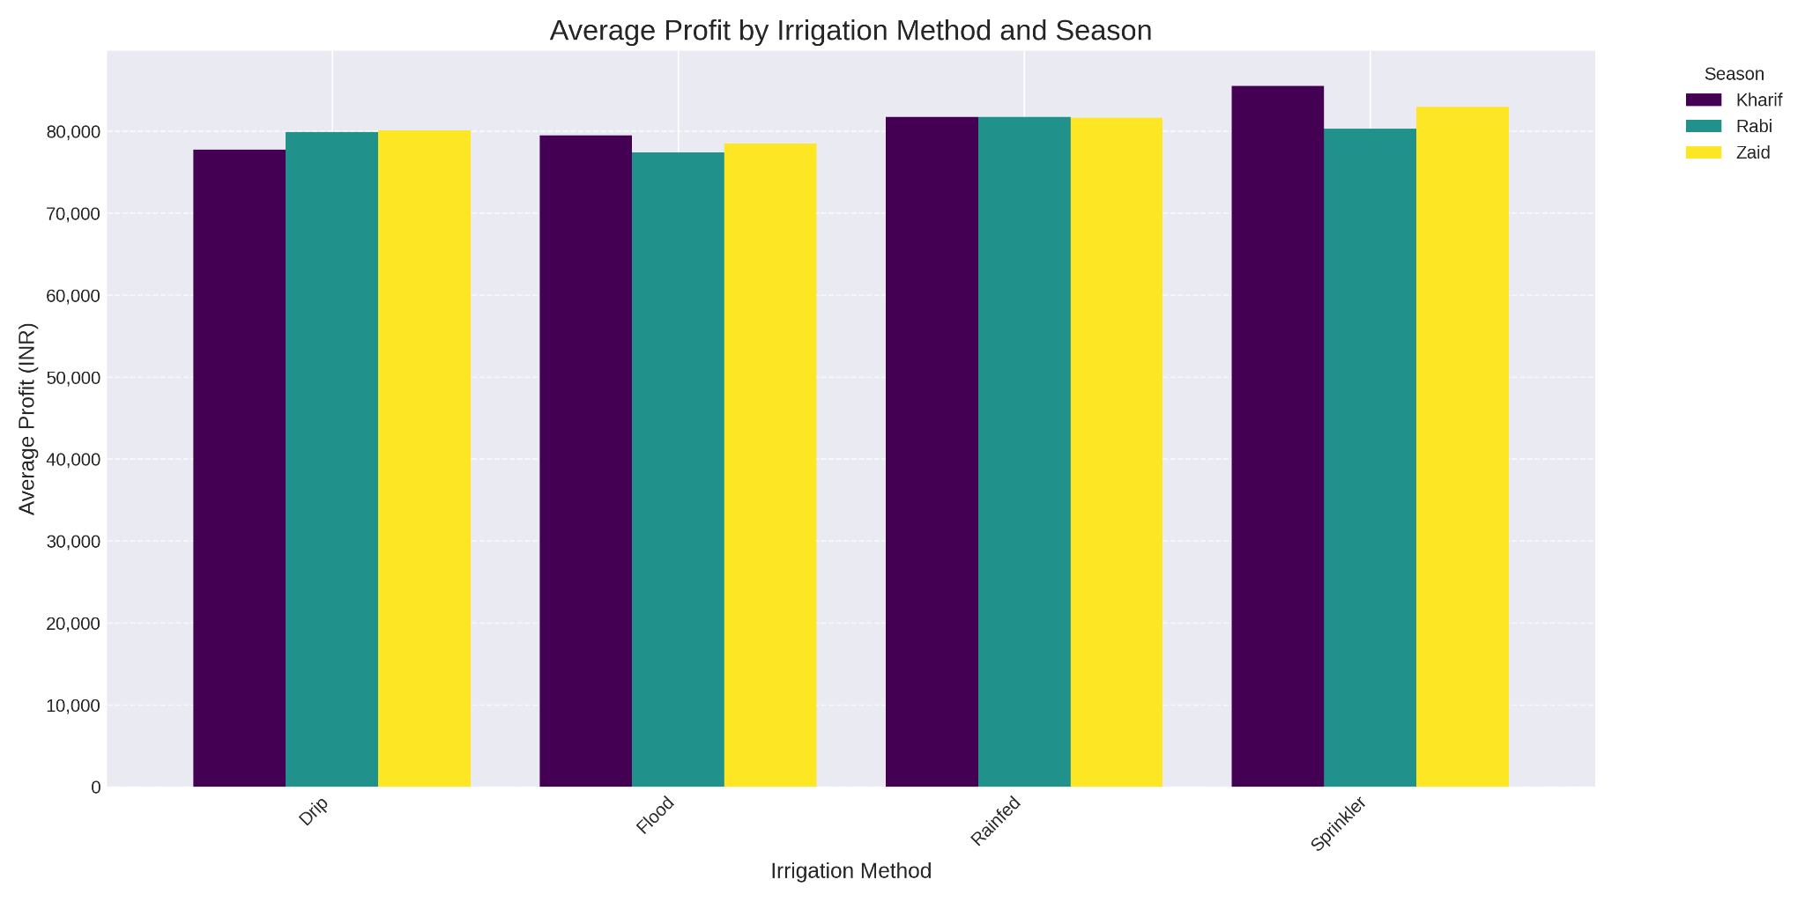
RESULTS
[Add screen shots of your code ]

Slide 15
Future scope
Predictive ML Modeling: Implement Machine Learning models (e.g., Random Forest, XGBoost) to forecast seasonal crop yields and financial profits based on real-time weather and soil inputs.
IoT & Precision Agriculture: Integrate real-time IoT sensor data (soil moisture, pH, humidity) to automate drip irrigation schedules and reduce water wastage.
Climate-Resilient Crop Recommendation: Develop AI-driven recommendation engines that suggest optimal crop choices and pest control strategies during harsh seasons like Zaid.
Granular Geographical Expansion: Expand the analysis across more states, districts, and soil micro-climates to improve localized farming advisories and agricultural policy decisions.

Slide 16
GitHub Link
Link: https://github.com/sreeniranjan10ks-max/Seasonal-Agriculture-Performance-Analysis.git

Slide 17
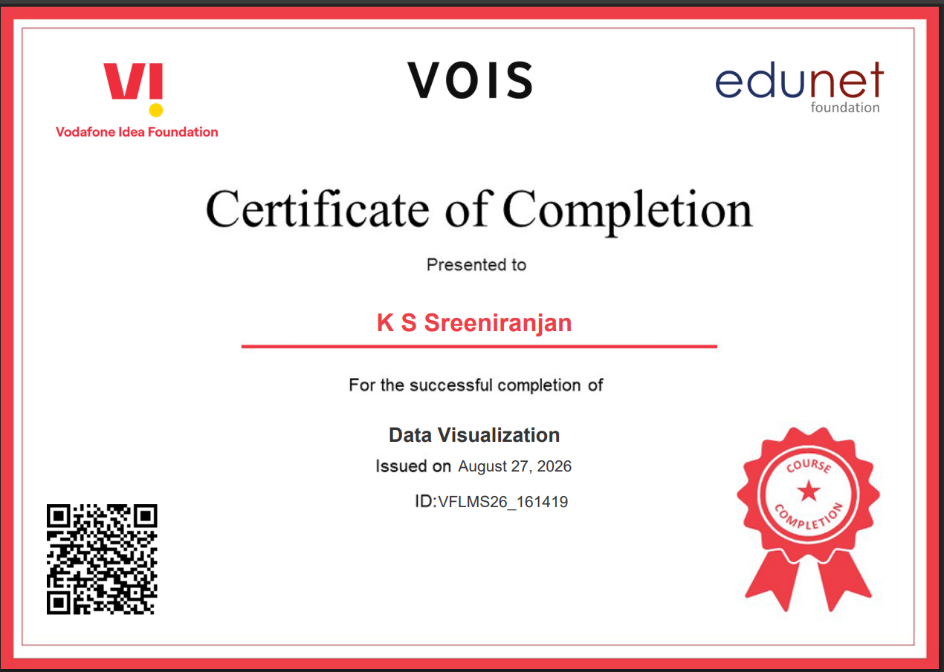
VOIS Course completion certificate - Course name- Data Visualization

Slide 18
Thank you
.
.

